Slide 1
Predicting Airbnb Prices Using Machine Learning and EDA
Danny Statland

Slide 2
TABLE OF CONTENTS
01
02
03
PROBLEM & SOLUTION
OUR PROCESS
Findings & Conclusions

Slide 3

Research question: What affects the price of an Airbnb property in Amsterdam
02
03
01
Personal motive
Business motive
Educational motive

Slide 4


UNDERSTANDING THE PROBLEM
Optimizing apartment renovation
Optimizing apartment locating
Optimizing publishing and property search
New
Publisher - Asymmetric information
Notes:
הבעיה העסקית ופתרונה:
פרסום דירות ראשוני
שיפוץ והתאמת הדירה
אופטימיזציה של פרסום וחיפוש דירות Airbnb
הבעיה

Slide 5
OUR SOLUTIONS
Defining
Visualizing
Suggesting
Optimizing
the features that significantly affect the price
And Monitoring the property features
30%
80 %
50%
Ways to improve the price of a specific property at a minimum cost
Property publishing

Slide 6





OUR PROCESS – EDA & Modeling
Cleaning & organizing the data
Preprocessing & Modeling
Findings & Conclusions
Stage 02
Stage 01
Stage 03
Stage 05
EDA
Stage 04
Evaluating

Slide 7
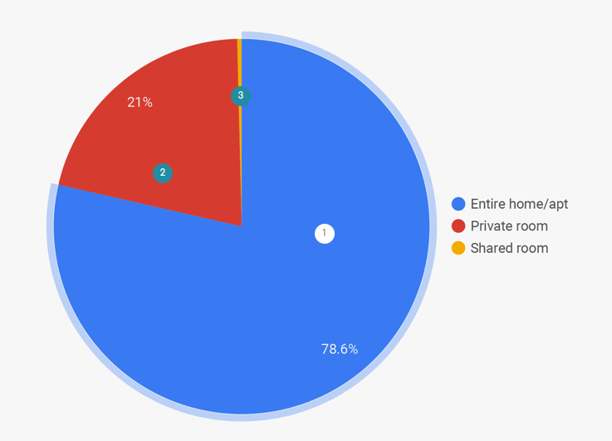
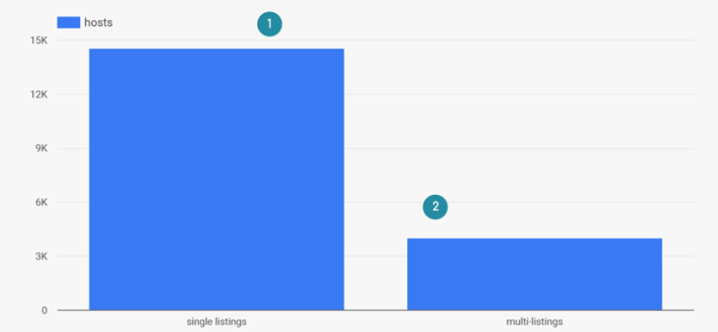
Our Market - Amsterdam Airbnb market
Over 1.97 million overnight stays in 2018
18,547 – listings in total
14,704 (78.6%) –entire properties
4,109 (21%) – private rooms
69 (0.4%) – shared rooms
3,998 (21.2%) – multi-listings
14,863 (78.8%) – single listings
www.hostyapp.com

Slide 8
Exploratory data analysis

Slide 9
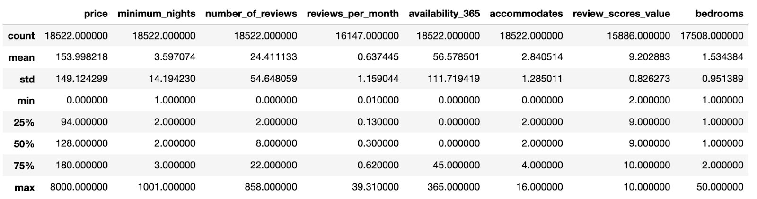
Our data
Data source: www.insideairbnb.com
19 Raw Data Features: 'id', 'name', 'host_id', 'host_name', 'neighbourhood_group', 'neighbourhood', 'room_type', 'price', 'minimum_nights', 'number_of_reviews', 'last_review', 'reviews_per_month', 'availability_365', 'first_review', 'host_total_listings_count', 'accommodates', 'review_scores_value', 'bedrooms', 'amenities']
* One of the main challenges of the data set we used is that the target variable (price) is the published price and not the real price that has been paid eventually.

Slide 10
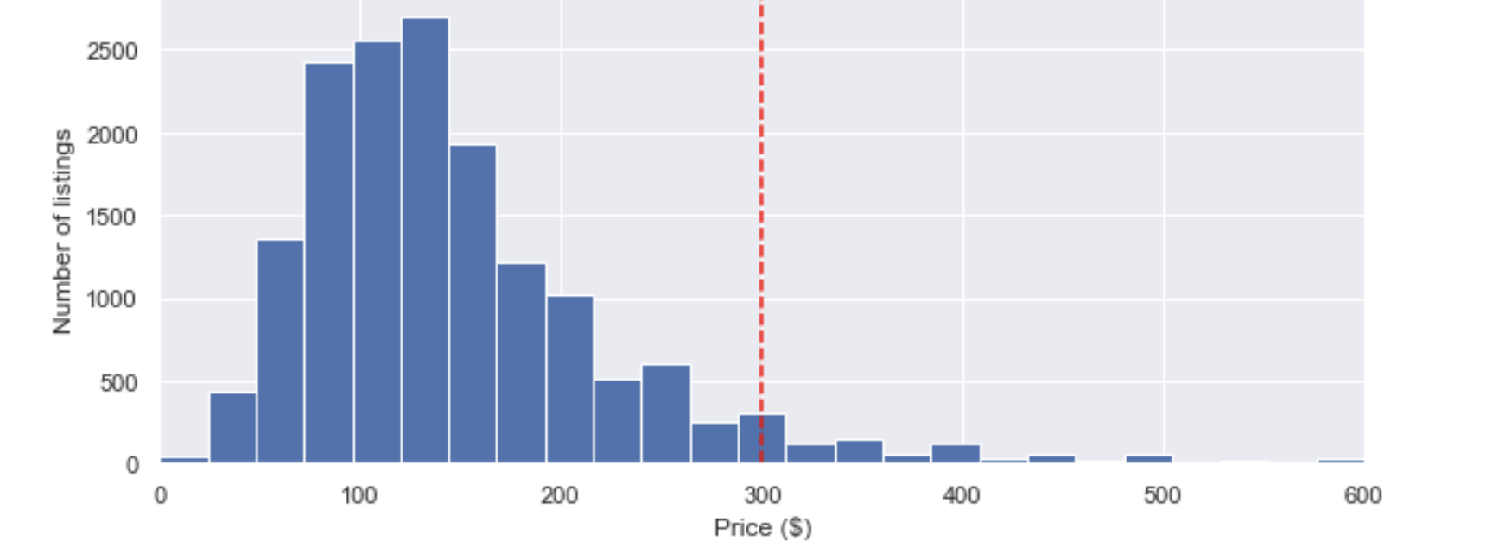
Airbnb advertised prices in Amsterdam up to 600$
Notes:
הקו האדום מראה את קו סטיית התקן הראשון מהממוצע

Slide 11
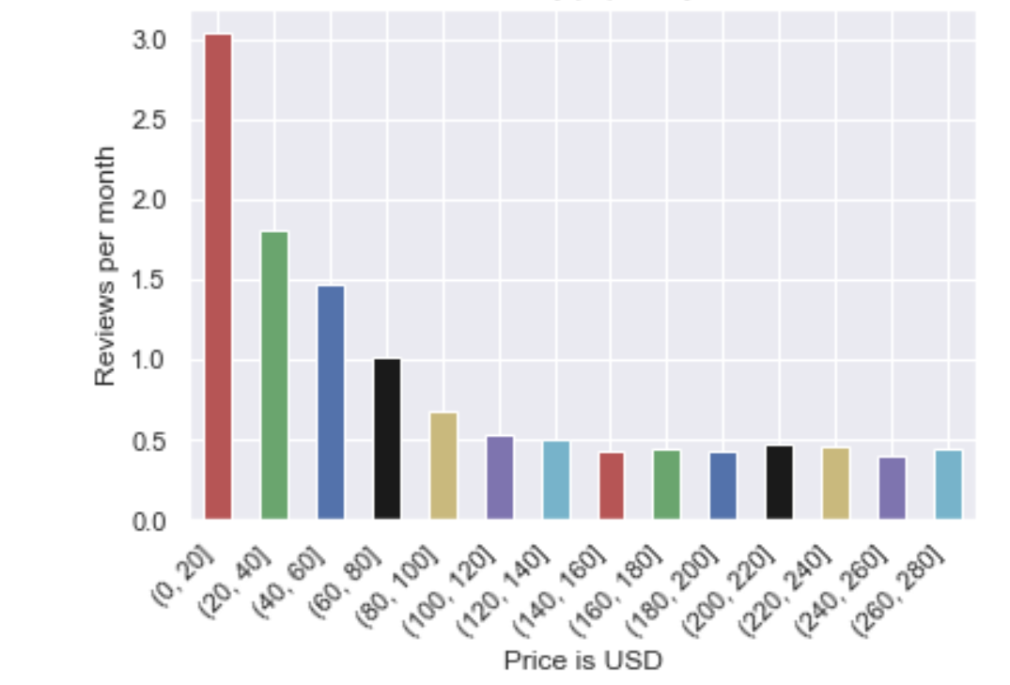
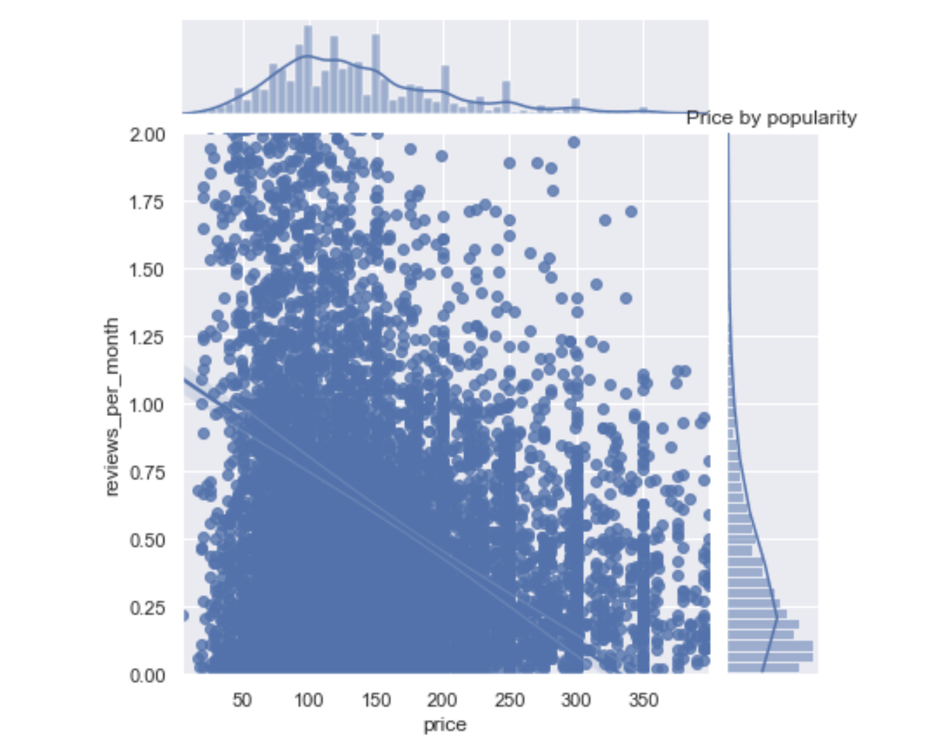
Price by popularity

Slide 12
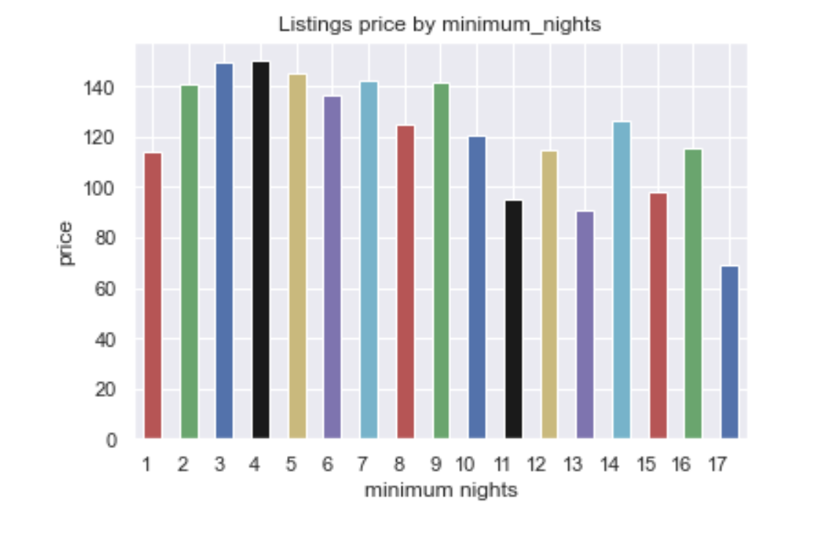
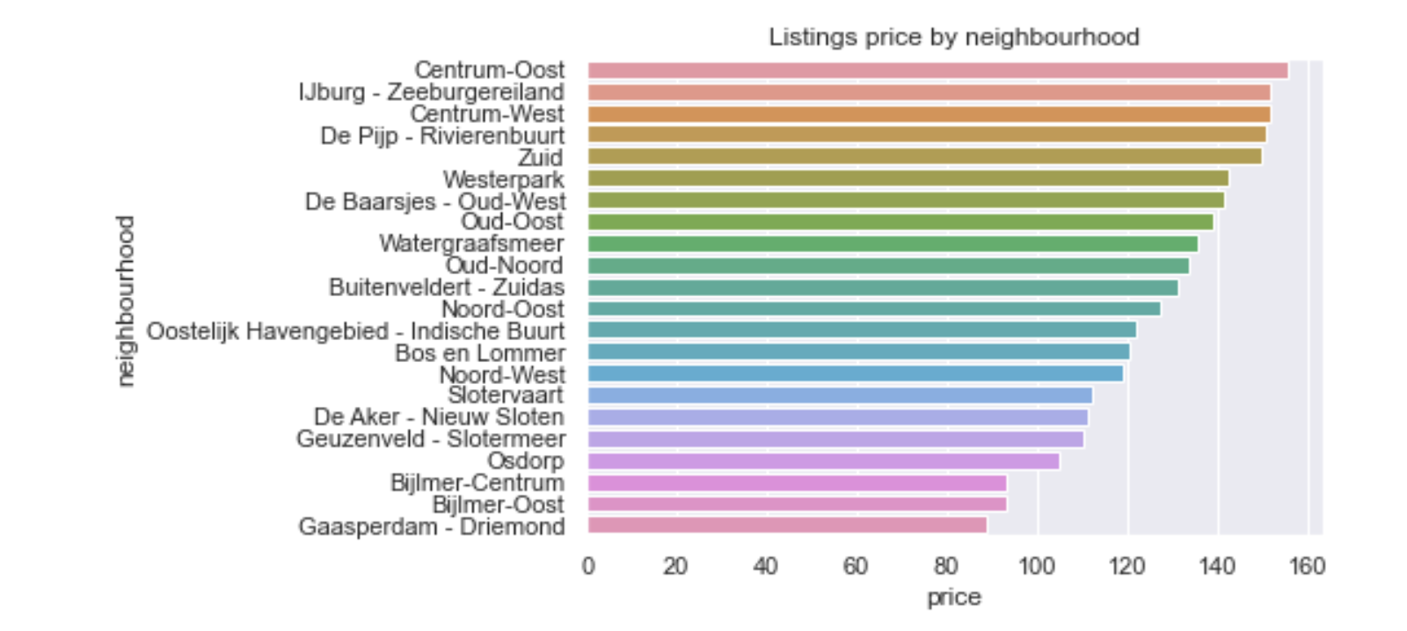
Listing price by minimum nights
Listing price by neighbourhood

Slide 13
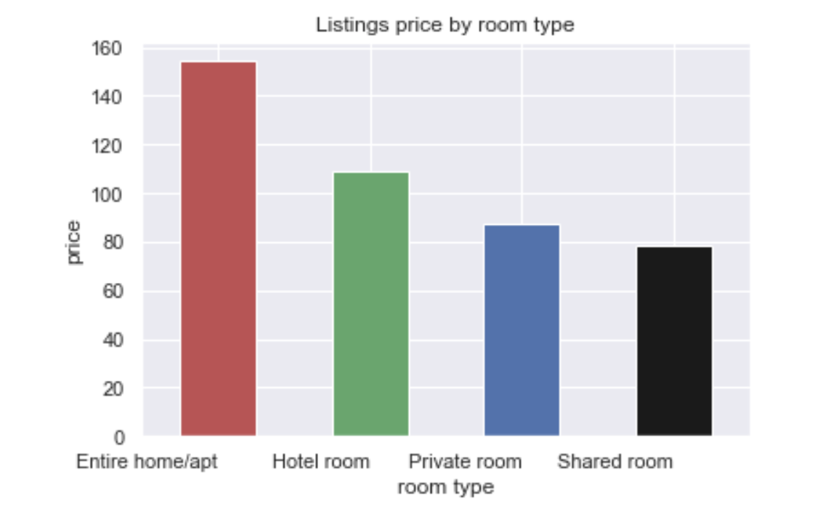
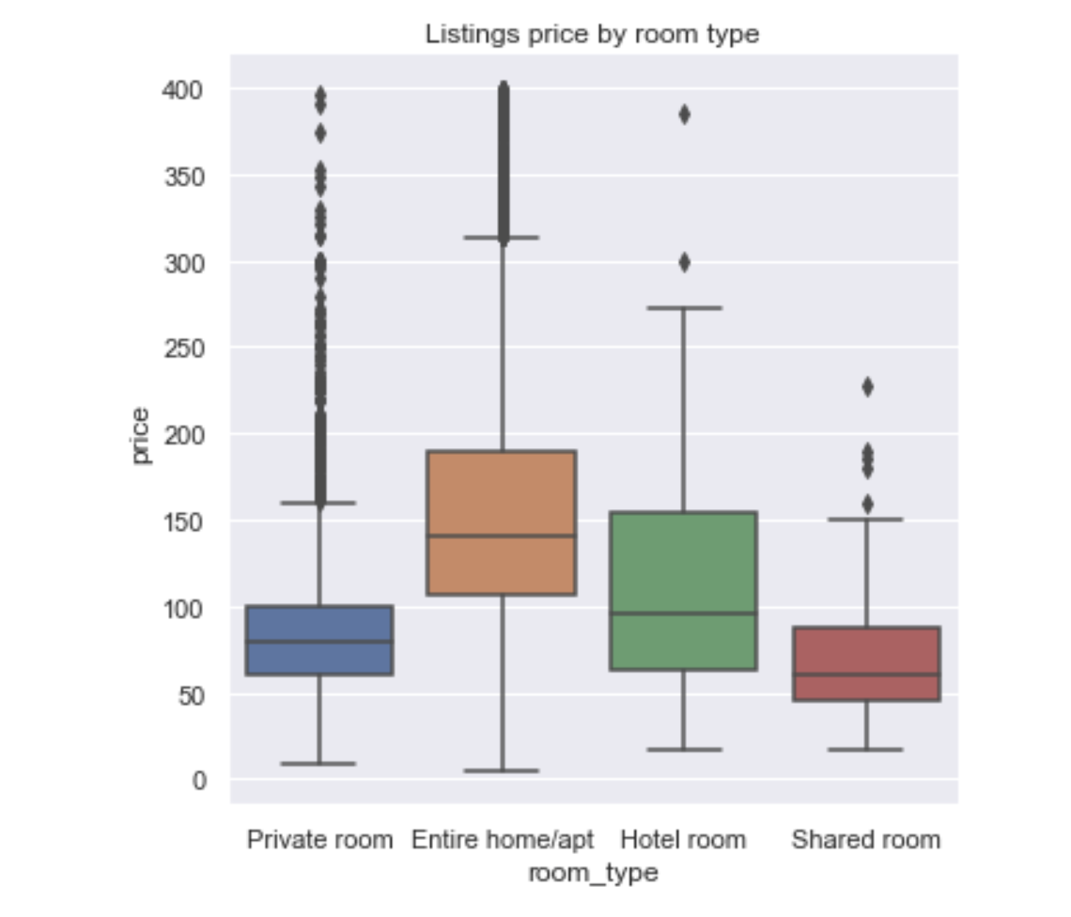
Listing by room type

Slide 14
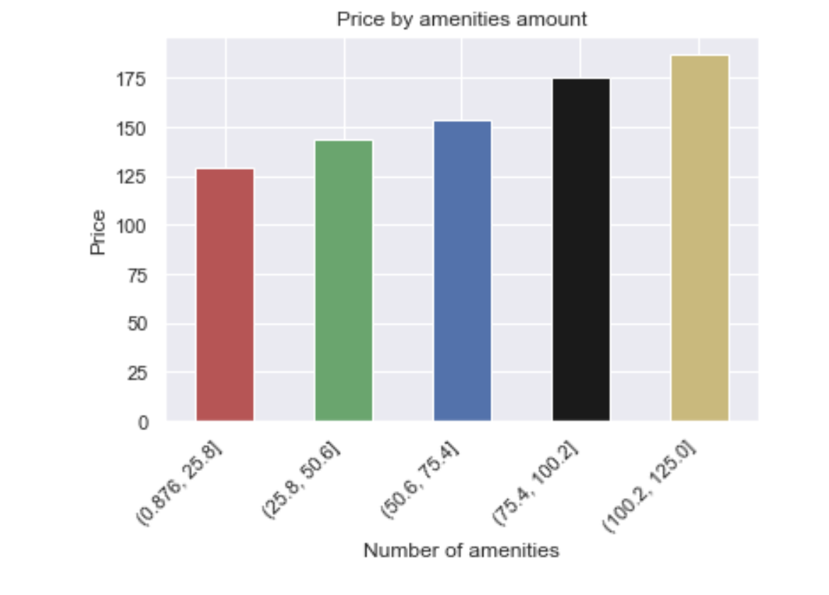
Price by amenities amount

Slide 15
Preprocessing

Slide 16
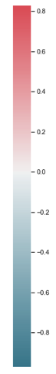
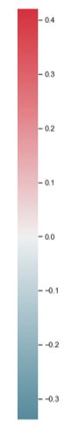
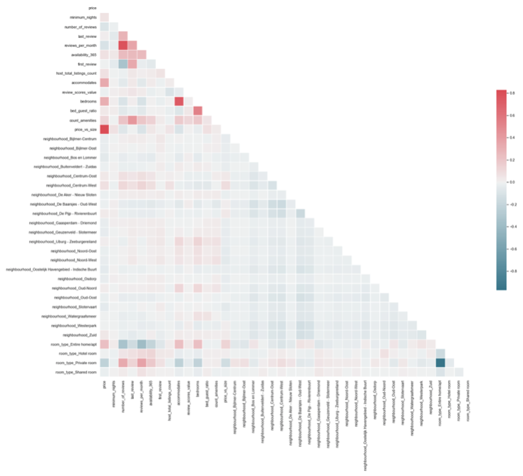
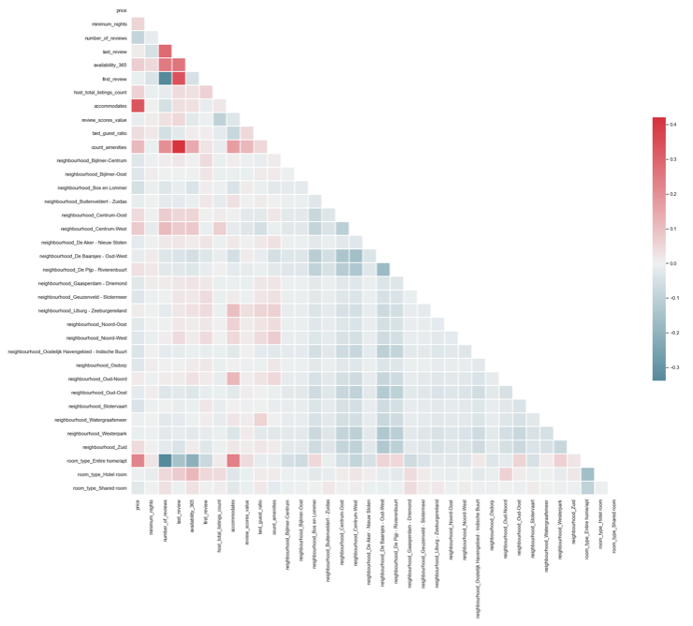
Dealing with collinearity
By dropping some features, we reduced the collinearity from 0.8 to 0.4

Slide 17
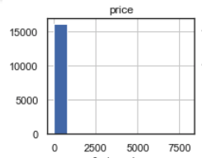
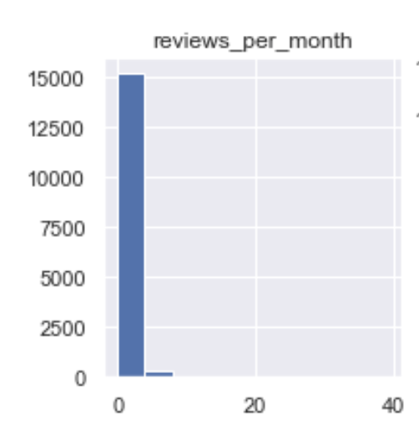
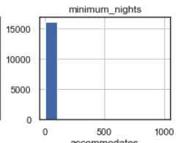
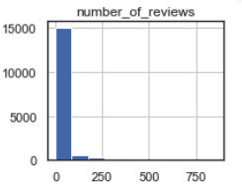
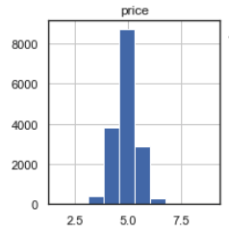
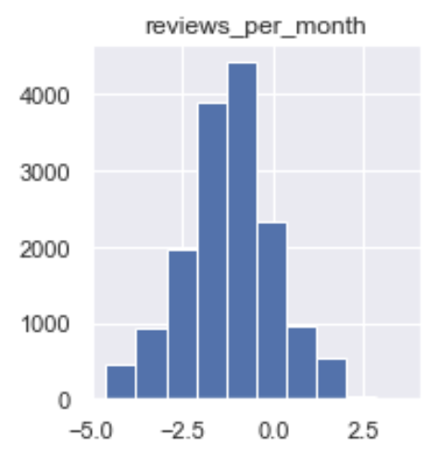
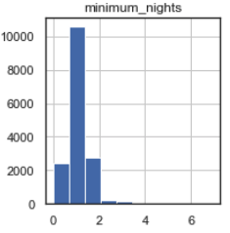
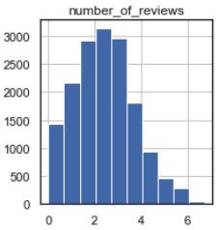
Log transformation
Before
After

Slide 18
Modelling

Slide 19
Choosing model type
Supervised
Linear Regression
XGboost
Random Forest
Continuous variable
18,522 Observations

Slide 20
Linear regression befor and after preprocessing
Measurements
Test Score
Mean 10-fold cross validation score
RMSE
MAE
Median AE
MAPE
Before
0.32
0.22
6,466.4
6.96
33.48
0.38
After
0.48
0.46
0.5
0.54
0.22
0.06

Slide 21
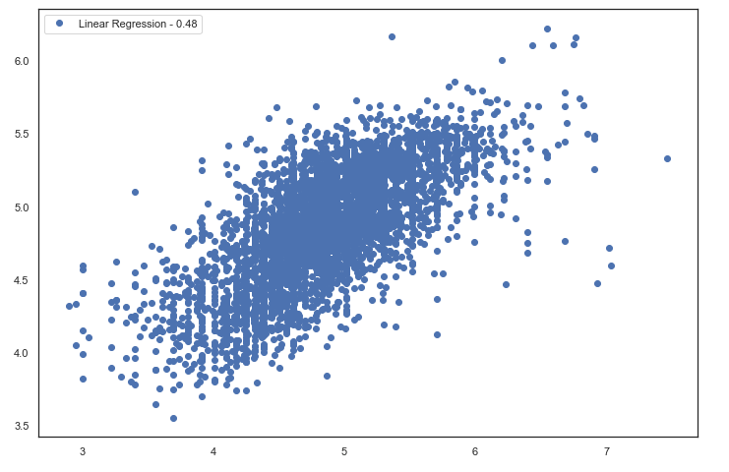
Linear Regression scatter plot

Slide 22
Random Forest score
Measurements
Test Score
Mean 10-fold cross validation score
RMSE
MAE
Median AE
MAPE
Score
0.46
0.42
0.15
0.54
0.23
0.06

Slide 23
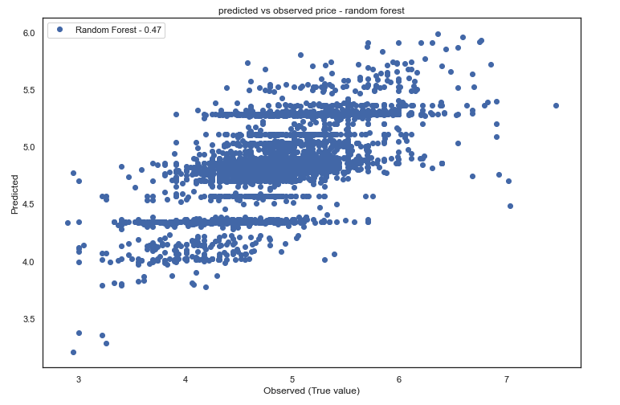
Random Forest scatter plot

Slide 24
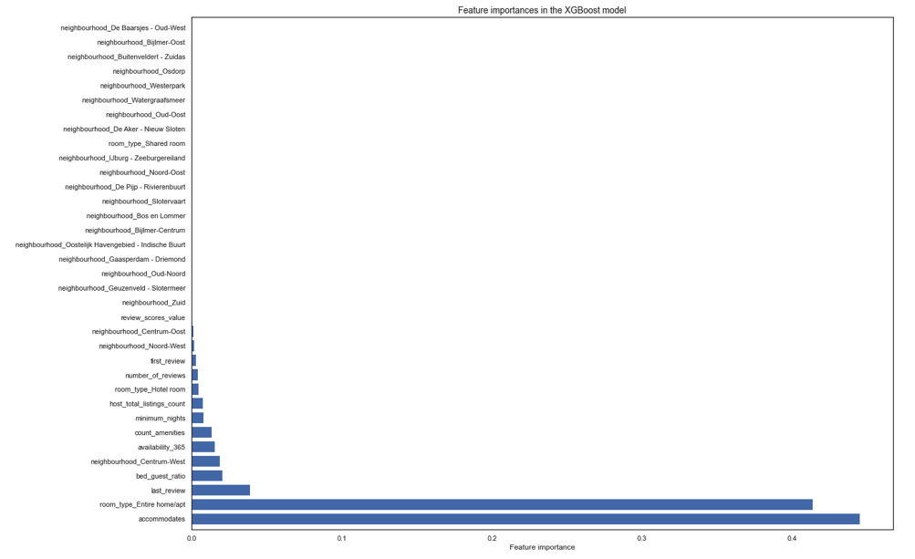
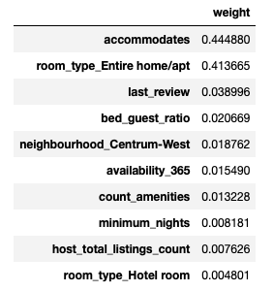

RF feature importances
TOP 10 FEATURES
Engineered feature

Slide 25
Xgboost score
Measurements
Test Score
Mean 10-fold cross validation score
RMSE
MAE
Median AE
MAPE
Score
0.53
0.51
0.13
0.52
0.21
0.05

Slide 26
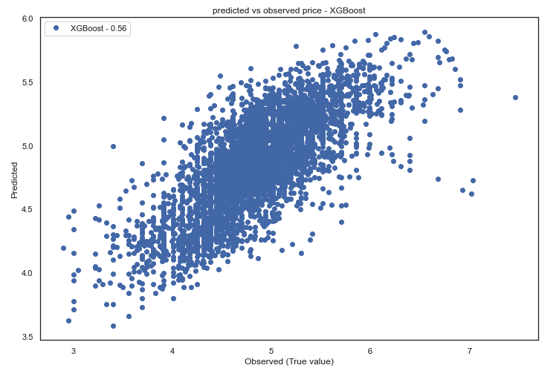
Xgboost scatter plot

Slide 27
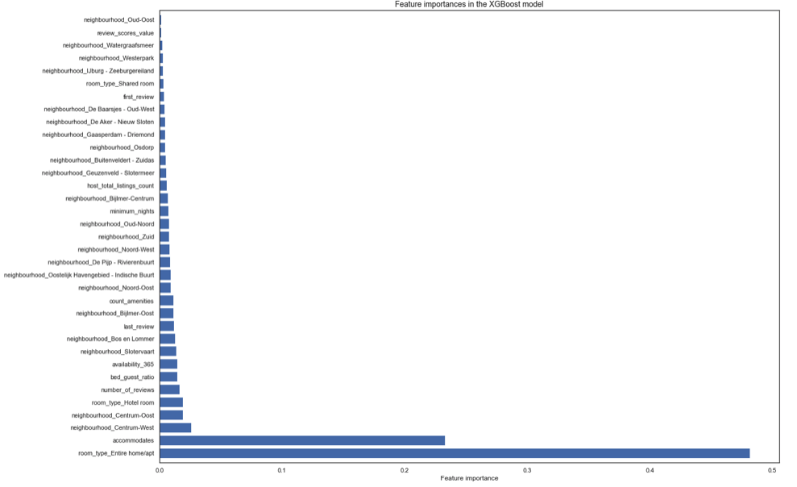
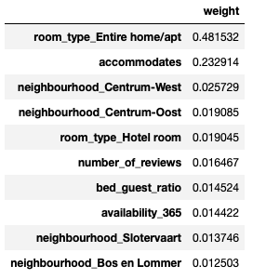
Xgboost feature importances
TOP 10 FEATURES
Engineered feature

Slide 28
Models comaprison
Measurements
Test Score
Mean 10-fold cross validation score
RMSE
MAE
Median AE
MAPE
LR
0.48
0.46
0.5
0.54
0.22
0.06
RF
0.46
0.42
0.15
0.54
0.23
0.06
XGB
0.53
0.51
0.13
0.52
0.21
0.05

Slide 29
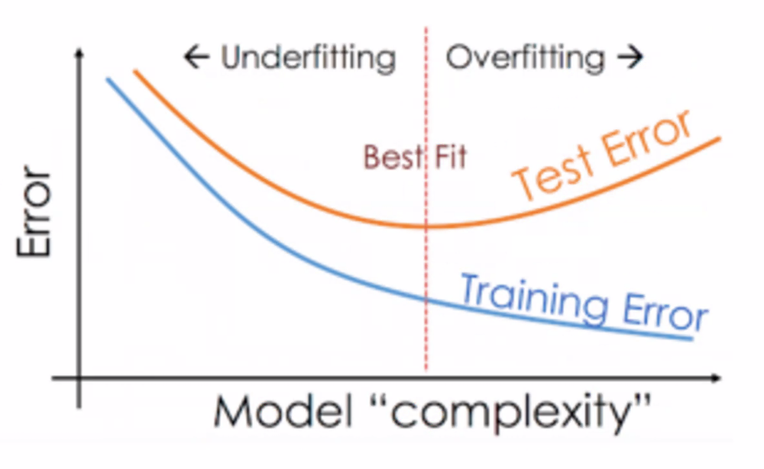
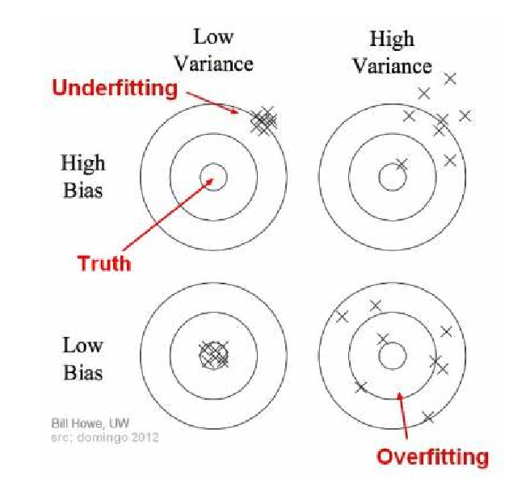
Why Xgboost gives the optimal result
High bias zone
High variance zone

Slide 30

Conclusions
Linear Regression
Random Forest
XGboost
Score: 0.48 RMSE: 0.5
Score: 0.46 RMSE: 0.15
Score: 0.53 RMSE: 0.13
high variance and
high bias
Low score and a
higher variance
Best score and best variance

Slide 31
THANKS

